Slide 1
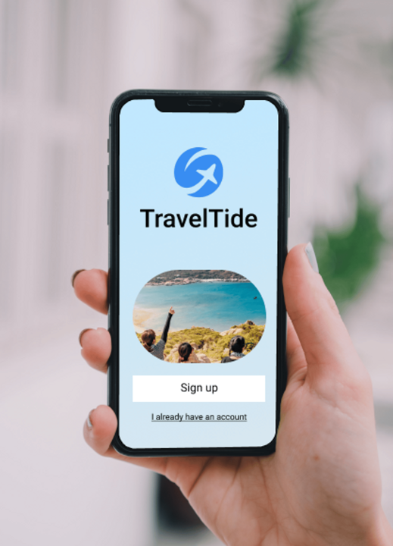

TRAVELTIDE
Customer Segmentation

Slide 2
The main goal of this project is to gain a deeper understanding of customer behavior and preferences within the TravelTide database. By applying clustering analysis, we aim to uncover distinct customer segments with defined traits, such as spending habits, booking patterns, and travel preferences, in order to assign each customer to one of five tailored perks based on their behavior.
Free Cancellation
Free Checked Bag
Exclusive Discounts
One Night Free Hotel With Flight
Free Hotel Meal

Slide 3
Customer Segmentation
One Night Free Hotel With Flight:This feature captures whether a customer receives a complimentary hotel stay for one night when booking a flight. It helps identify customers who value bundled travel and accommodation offers.
Free Hotel Meal:This feature indicates whether a customer benefits from complimentary meals at hotels. It allows analysis of customer preferences for in-hotel dining and their potential value for inclusive amenities.
Free Cancellation:This feature highlights whether a customer has access to free cancellation of bookings. It helps assess the importance of flexible booking options and how it influences customer behavior and satisfaction.
Free Checked Bag:This feature shows whether a customer is entitled to check in one or more bags for free. It provides insights into the value customers place on baggage allowances and their impact on travel choices.
Exclusive Discounts:This feature reflects whether a customer receives special discounts on future bookings or other services. It is useful for understanding the appeal of promotional offers and their influence on customer loyalty and repeat business.

Slide 4
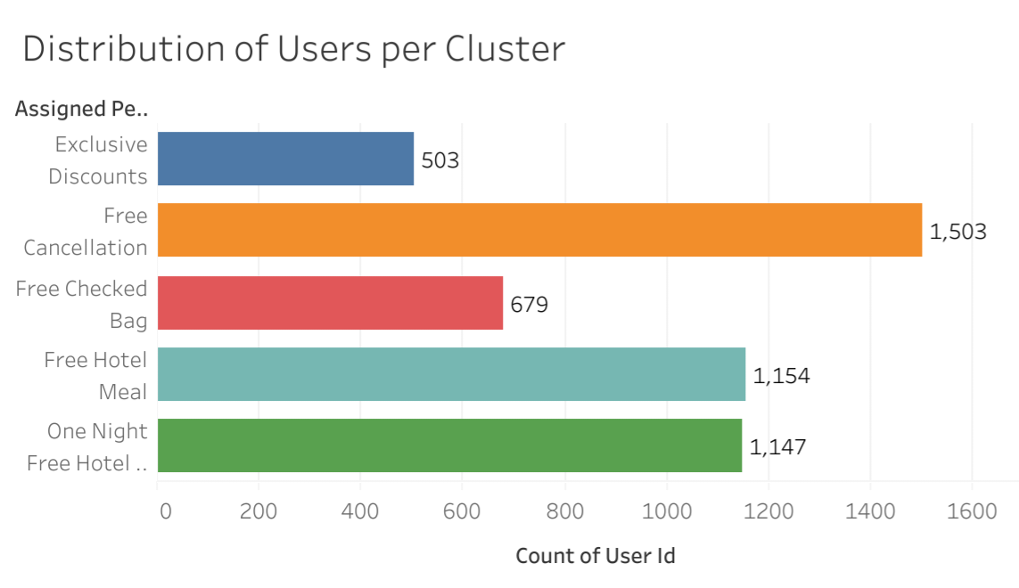

Slide 5
Findings
Insights:
The "Exclusive Discounts" cluster prioritizes cost-effective bookings, highlighting a strong preference for discounts and bargains.
The "Free Hotel Meal" cluster demonstrates a clear interest in dining perks, suggesting these travelers value complimentary meals during their stay.
The "Free Checked Bag" cluster reveals that customers in this group are particularly focused on baggage-related benefits.

Slide 6
Cluster Sizes:
The "Exclusive Discounts" cluster, often associated with bargain hunters, is the smallest group.
In contrast, the "Free Cancellations" cluster, which consists of cost-conscious customers who rarely cancel, represents the largest segment.
Gender Balance:
The data reveals a majority of female users, presenting a potential opportunity to develop targeted marketing strategies aimed at engaging more male customers and diversifying the overall customer base.

Slide 7
Recommendations
1. Multi-Level Rewards: Implement a tiered rewards system to address different stages of customer engagement. Leverage preference overlaps to enhance booking activities. Consider consolidating perks such as "Free Hotel Meal" and "One Night Free Hotel With Flight" to simplify and maximize appeal.
2. Periodic Refinement: Regularly re-segment customer data using a comprehensive dataset to ensure nuanced segmentation. Adapt to evolving customer preferences to enhance targeting accuracy and effectiveness.
3. Feedback Mechanism: Establish a robust feedback system to gather direct customer input. Use this feedback to continually refine the program, ensuring it remains relevant and appealing.
4. Targeted Marketing: Develop tailored marketing campaigns based on customer cluster preferences. Align messaging and perks with these preferences to increase engagement and foster loyalty.
5. Gender Balance: Address gender imbalances within the program to promote diversity and inclusivity. This approach will broaden the program’s reach and enhance its overall appeal.

